Slide 1
Spring 101
Thorsten Göckeler

Slide 2
Dependency Injection
public class SearchProduct {
public List<Product> findByArtist(String nameStart) {
…
}
}

Slide 3
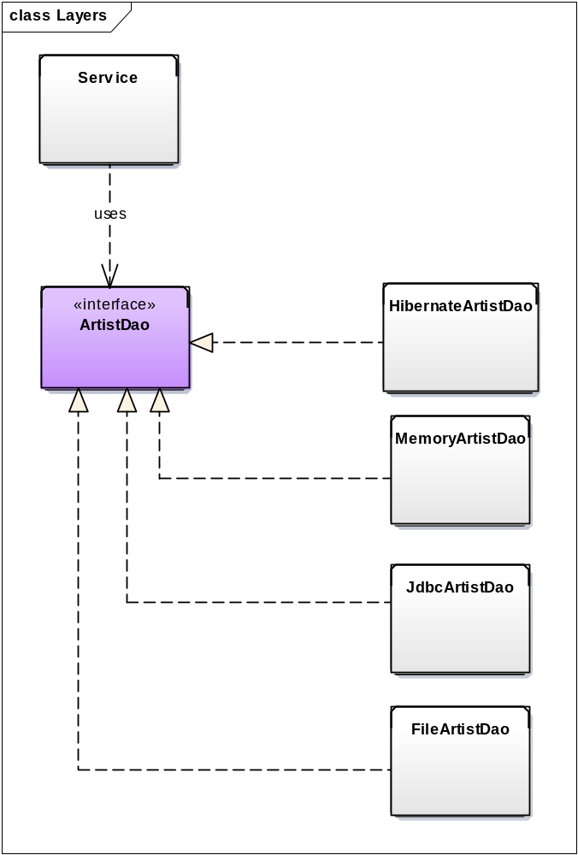
Dependency Injection
public class SearchProduct {
public List<Product> findByArtist(String nameStart) {
List<Product> products = new ArrayList<>();
for (Artist artist : artistDao.find(nameStart)) {
products.addAll(productDao.find(artist);
}
return products;
}
}
ArtistDao «Interface»
find (…) : List<Artist>
....
ArtistDaoImpl
find( ) : List<Artist>
....

Slide 4
Dependency Injection
public class SearchProduct {
private ArtistDao artistDao;
public SearchProduct() {
artistDao = new HibernateArtistDao();
}
public List<Product> findByArtist(String nameStart) {
List<Product> products = new ArrayList<Product>();
for (Artist artist : artistDao.find(nameStart)) {
products.addAll(productDao.find(artist);
}
return products;
}
}

Slide 5
Dependency Injection - Constructor
public class SearchProduct {
private ArtistDao artistDao;
public SearchProduct(ArtistDao artistDao) {
this.artistDao = artistDao;
}
public List<Product> findByArtist(String nameStart) {
…
}
}

Slide 6
Dependency Injection - Setter
public class SearchProduct {
private ArtistDAO artistDao;
public void setArtistDao(ArtistDao artistDao) {
this.artistDao = artistDao;
}
public List<Product> findByArtist(String nameStart) {
…
}
}

Slide 7
Dependency Injection mit Spring (klassisch)
<beans>
<bean id="artistDao“ class=“com.x.dao.HibernateArtistDao" />
<bean id="searchProduct" class="com.x.service.SearchProduct" >
<property name=“artistDao” ref=“artistDao”>
</bean>
</beans>

Slide 8
Dependency Injection mit Spring (per Annotation)
@Component
public class SearchProduct {
@Autowired
private ArtistDAO artistDao;
public List<Product> findByArtist(String nameStart) {
…
}
}

Slide 9
Annotations
@Component
@SpringBootApplication
@Autowired
@ComponentScan
@Resource
@Value("${…}")
@ContextConfiguration
@RestController
@IfProfileValue
@RequestMapping
@Aspect
@Transactional

Slide 10
Fragen? Let’s code!
Thorsten Göckeler

